Slide 1
Analytics Presentation
Implementation of LACE
Michael Bernauer, Jemal Ebrahim

Slide 2
Objectives
Describe the current state of readmissions within our institution
Describe the development of model to predict patient at high risk of readmission
Notes:
Briefly introduce the concept
“Over the next 15 minutes I will introduce a risk score that will help us predict the risk of inpatient readmissions. I will lay out the need for change, introduce you to the model, and discuss how you will play a role in the success of this effort.”
I frequently see analysts spend too much time setting the stage and defining the need for change (next section). Do not fall into this trap. You will run out of time and lose your opportunity to explain the model and how it will help!

Slide 3
Current State of Readmissions
150 readmissions per 1,000 index visits
Index visits (n = 34,532)
Median LOS is 6 days
5,169 visits with readmit within 30 days
Readmissions (n = 5,169)
Median LOS is 10 day
49,300 patient days
15% all patient days delivered between Jan-Nov 2014

Slide 4
Impact of not changing
Continued high readmission rate
Increased cost
Financial cost of care
Personnel and resource consumption
Reduced medicare/medicaid reimbursement
Poor patient outcomes
Patient satisfaction
Sequelae/complication of disease → increased complexity of care

Slide 5
LACE
Length of stay, acuity of illness, prior ED use, and comorbidities have been shown to correlate with readmission risk
LACE model has been previously validated to predict readmission risk
LACE implements covariates that have already been collected secondary to patient care
No extracurricular data collection required

Slide 6
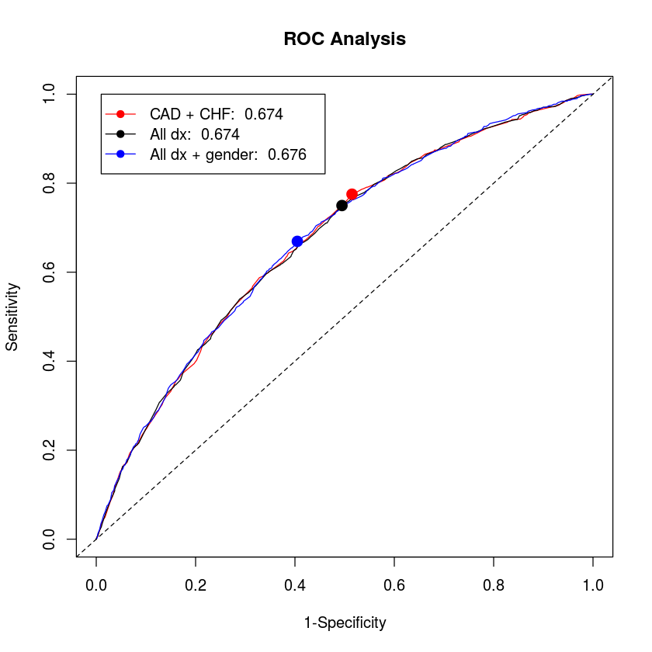

Slide 7
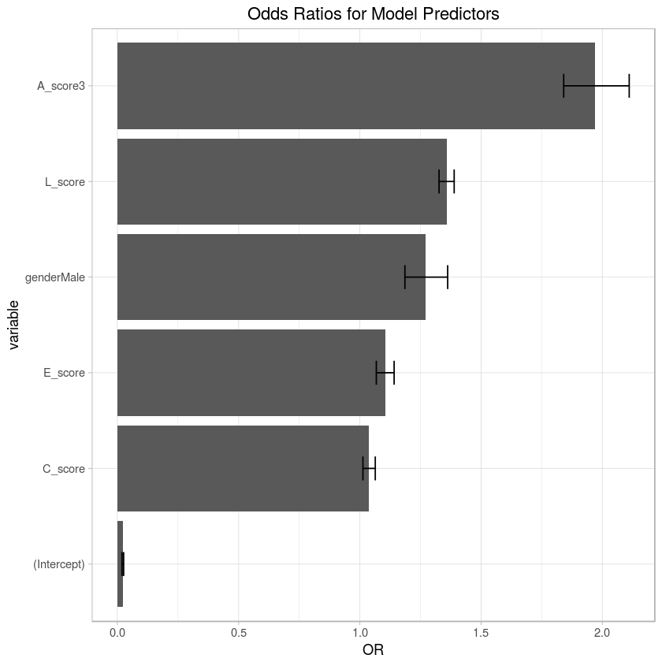
Final Model Coefficients
Predictor | Odds Ratio
L | 1.36 (1.33,1.39)
A | 1.97 (1.84,2.11)
C | 1.04 (1.01,1.06)
E | 1.10 (1.07, 1.14)
Gender (Male) | 1.27 (1.19,1.36)

Slide 8
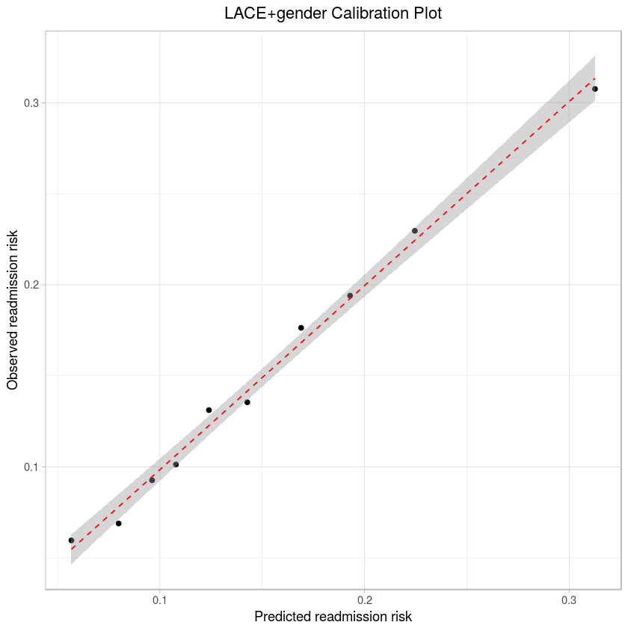

Slide 9
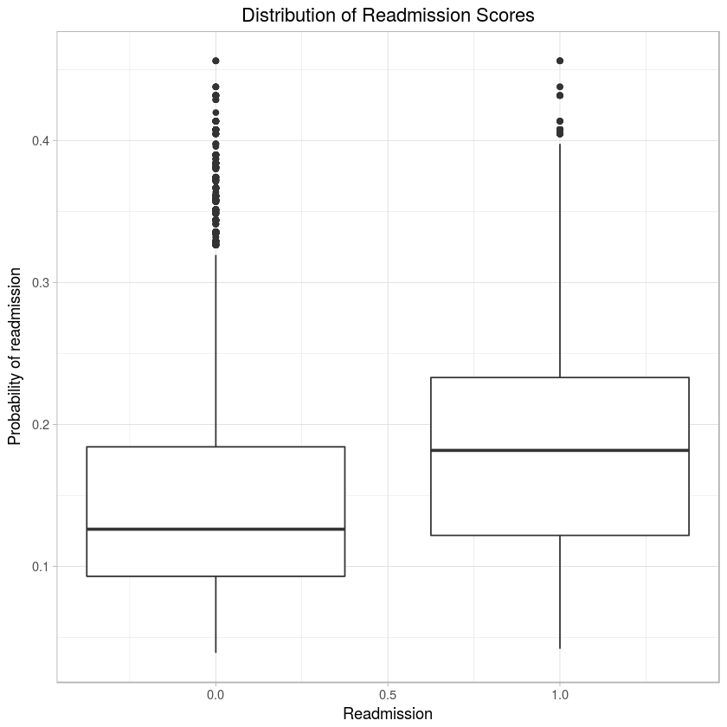

Slide 10
Model Summary
Accuracy | AUC | Sensitivity | Specificity | PPV | Threshold
60.7% | 0.676 vs 0.684 | 0.67 | 0.59 | 22% | 0.15
5,169 visits resulting in readmission
3,293 would have been flagged for follow-up
Potentially preventing 31,512 patient days (down from 49,300)
A 64% reduction in patient days

Slide 11
Why use LACE
Importance of LACE implementation
Patient
HCO and its leaders
Clinicians
Impact of LACE implementation
Increased patient care
Decreased cost of care and resources
Increased ROI.

Slide 12
Final note
Role of HCO and leaders
Implement LACE
cost of care
quality of care
decrease readmission
The clinicians
participate in the implementation of the Lace
actively use LACE
Analysts

